Slide 1
Instructions
International Living Donor Liver Transplant Registry
LDLTregistry.org
LDLT

Slide 2
Instructions contents
About LDLTregistry.org
Platform navigation
Register for an account
Form your local team / assign a data auditor
Audit / Quality Improvement Program / Ethics / IRB registration
The electronic Case Report Form (CRF) / submit cases
Access submitted cases for editing
Contact us
ILDLT | LDLTregistry.org | ILTS

Slide 3
About LDLTregistry.org
Aim
Capture outcome data on all LDLT donors and recipients worldwide
Identify the true morbidity, mortality and independent predictors of outcome
Allow evidence-based evolution of LDLT practice
Data
Data will belong to all LDLTregistry.org members.
Local data monitors will ensure completion and quality.
Authorship
All members will be PubMed cited as group authors in all publications.
Ethics
This project can be approved as an audit, quality improvement program, may require formal ethics / IRB approval by the local institutions. It is the responsibility of the local PI to receive approval
ILDLT | LDLTregistry.org | ILTS

Slide 4
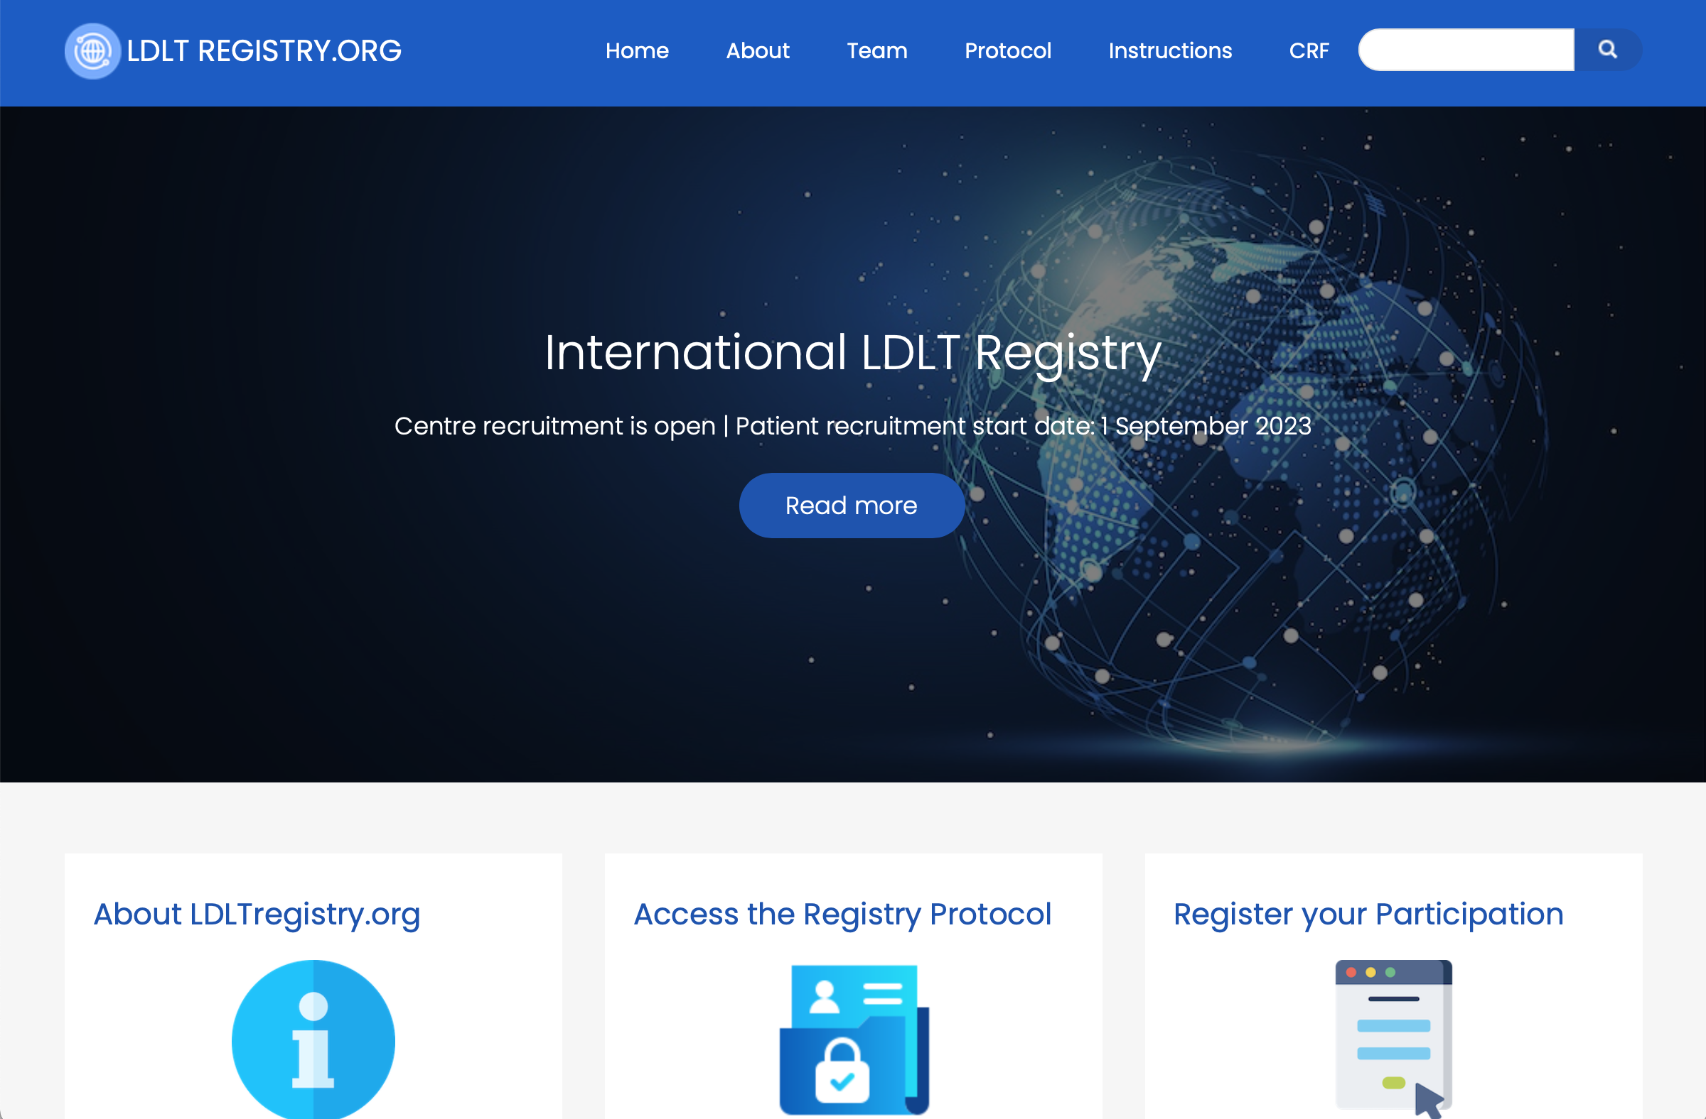
LDLTregistry.org Platform
Please type LDLTregistry.org at your browser address bar to access the LDLTregistry.org platform.
You may use the top menu bar to access the “About”, “Team”, “Protocol”, “Instructions”, etc. pages.
More useful links are also available at the right sidebar and footer of the platform.
ILDLT | LDLTregistry.org | ILTS

Slide 5
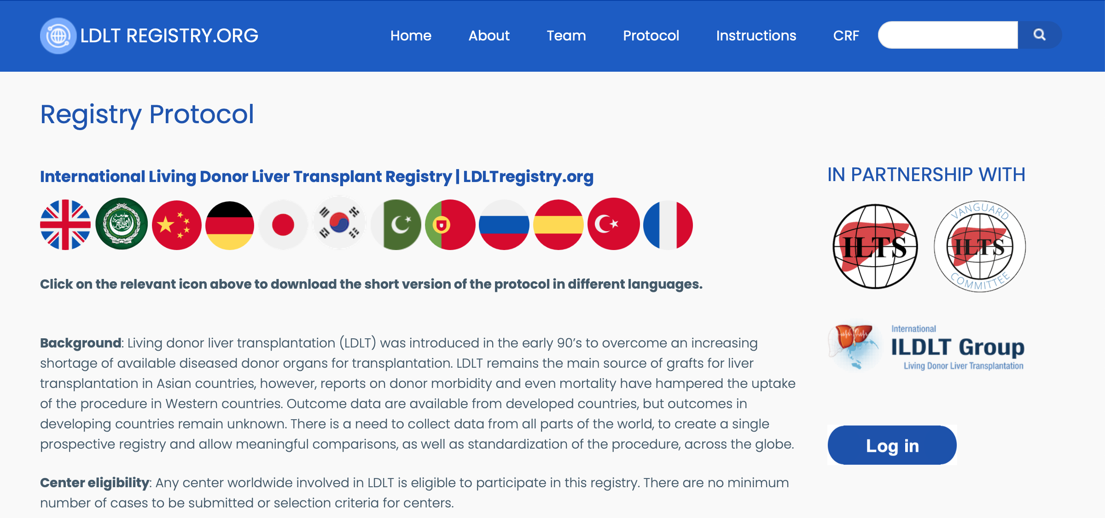
Protocol
Please read the short version of the registry protocol.
This is available in 12 different languages from the countries that perform the most LDLT.
ILDLT | LDLTregistry.org | ILTS

Slide 6
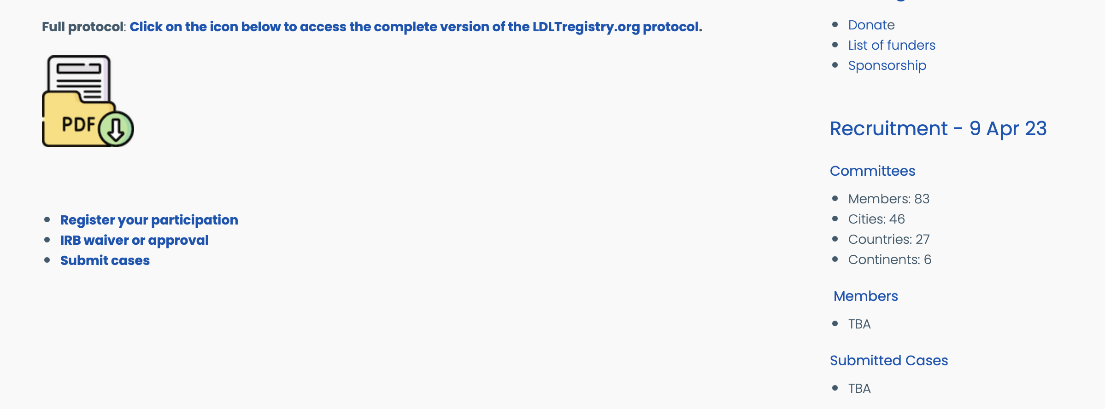
Protocol
The full version of the registry protocol is available for download at the end of the page.
This is currently available only in English however it will be translated in different languages soon.
This protocol can be used to request audit, quality improvement program, ethics and IRB approval.
ILDLT | LDLTregistry.org | ILTS

Slide 7
Protocol
Please read the full version of the registry protocol before starting recruiting patients.
This is available for download in PDF format.
ILDLT | LDLTregistry.org | ILTS

Slide 8
Registration
Please register your participation by clicking on this icon.
ILDLT | LDLTregistry.org | ILTS

Slide 9
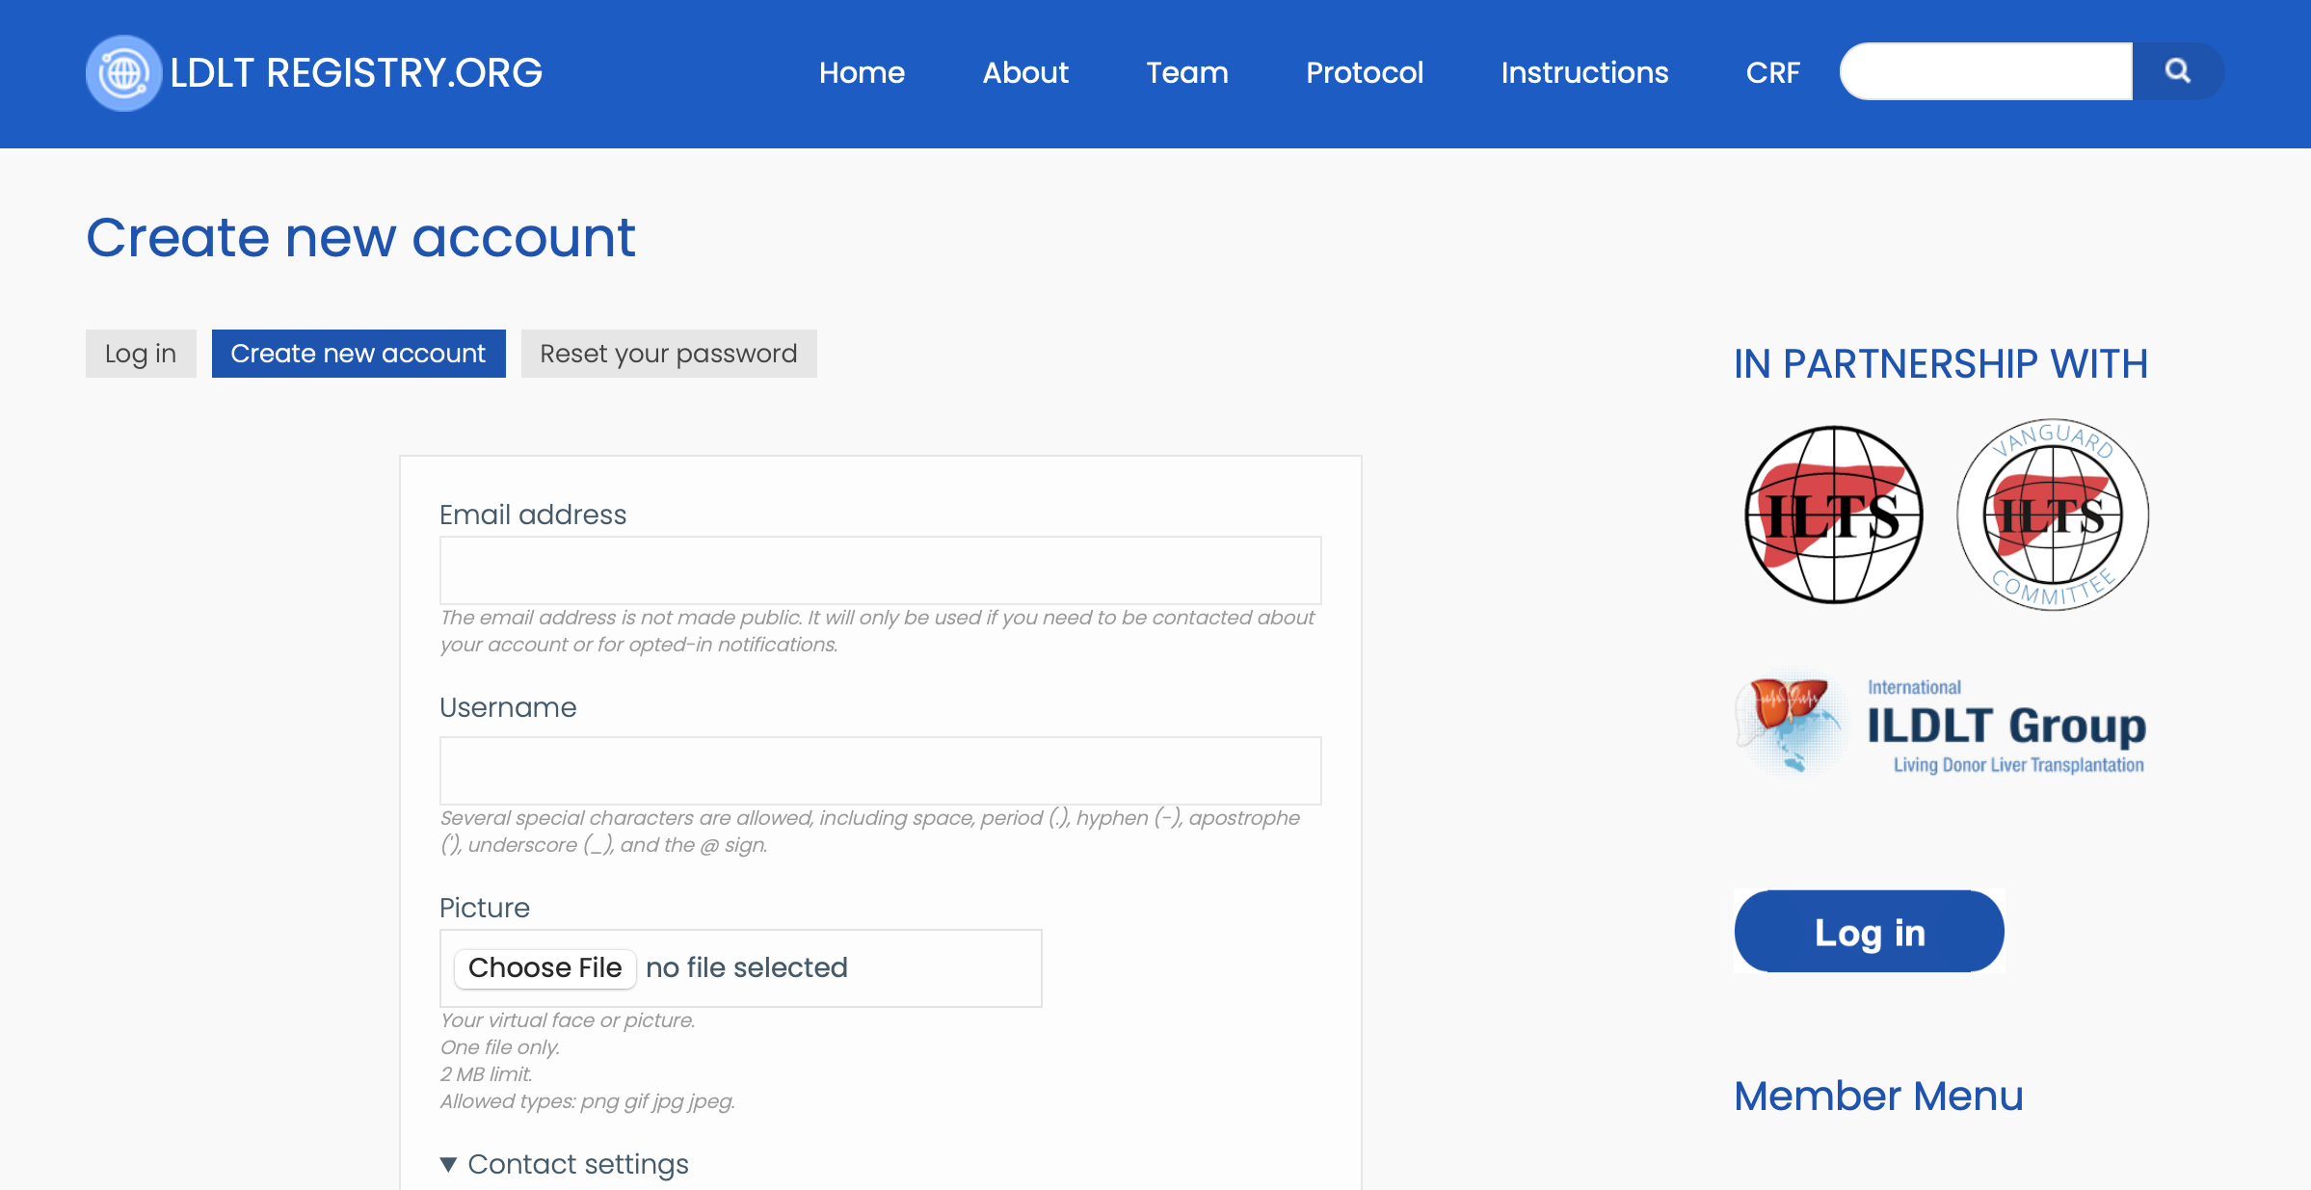
Registration
This is the registration form available at LDLTregistry.org. Please complete it accurately.
This information will be used for future publications and authorship.
ILDLT | LDLTregistry.org | ILTS

Slide 10
Registration
Select yes if you would like to become a country leader.
Country leaders' additional responsibility is to recruit centers from their own country.
Please add here the full name of the 2nd local collaborator of your institution. These details will be used for authorship in future publications.
Each local team will be comprised of 3 investigators and one independent data auditor (monitor, non-surgeon).
Add here the email address of the 2nd local collaborator.
Add here the full name of the 3rd local collaborator.
Add here the email address of the 2nd local collaborator.
Add here the full name of the data auditor.
Add here the email address of the data auditors.
See below for more information.
ILDLT | LDLTregistry.org | ILTS

Slide 11
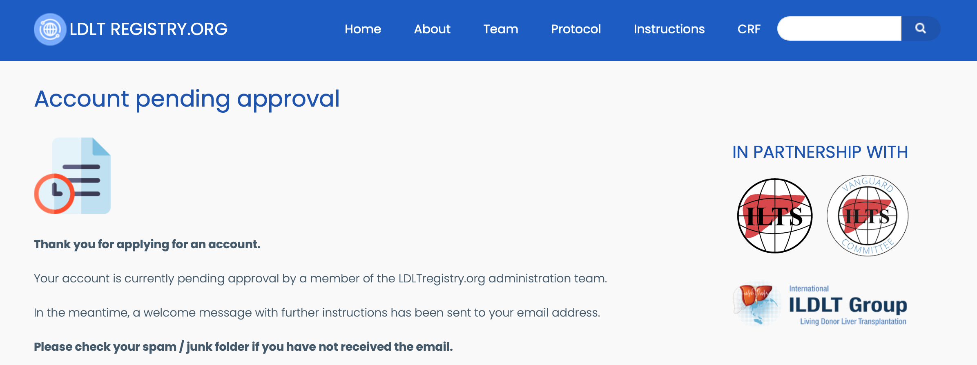
Registration
Once you submit the form to request for a new account, you will receive an automated email.
Please check your spam folder if you have not received it.
A member of our Administration team will review the information and activate your account
within 48 hours. This is for security purposes. Please check your spam folder again to ensure that
you access this email; It will prompt you to create your password and allow you to login to the platform.
You can only access the electronic Case Report Form (eCRF) / case submission page only if you are logged in to the platform.
ILDLT | LDLTregistry.org | ILTS

Slide 12
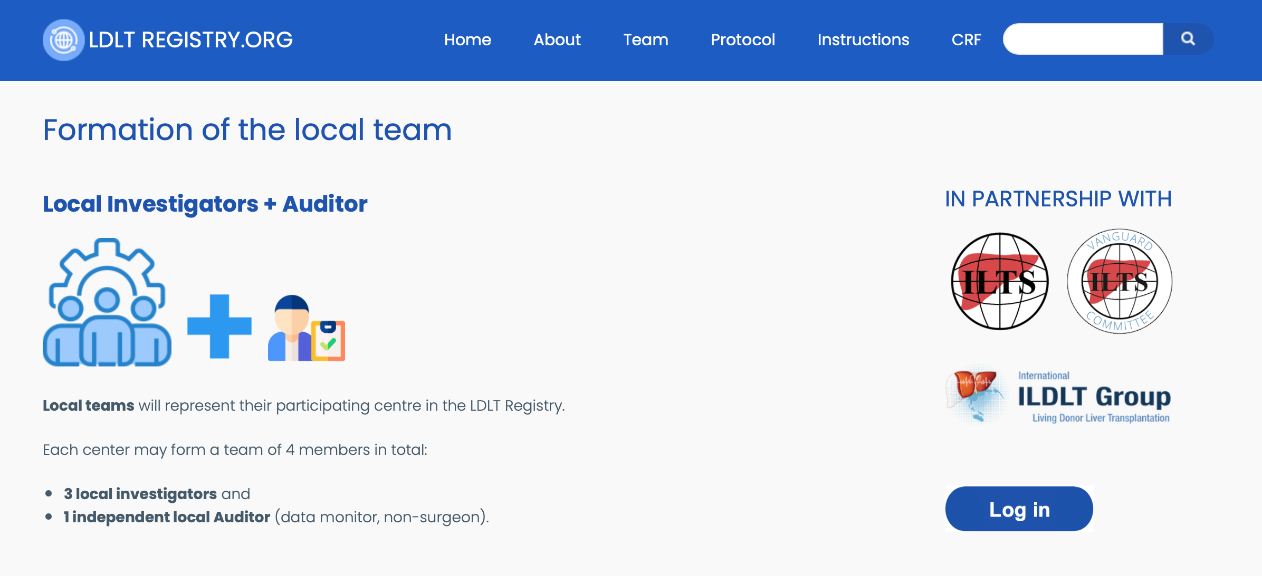
Local team
Local teams will represent their participating center in the LDLT Registry.
Each center may form a team of 4 members in total:
3 local investigators and
1 independent local Auditor (data monitor, non-surgeon).
In high volume centers, it is allowed to create more than one local team of 3 per senior surgeon
after request by email to our administration and management committee (see contact page).
ILDLT | LDLTregistry.org | ILTS

Slide 13
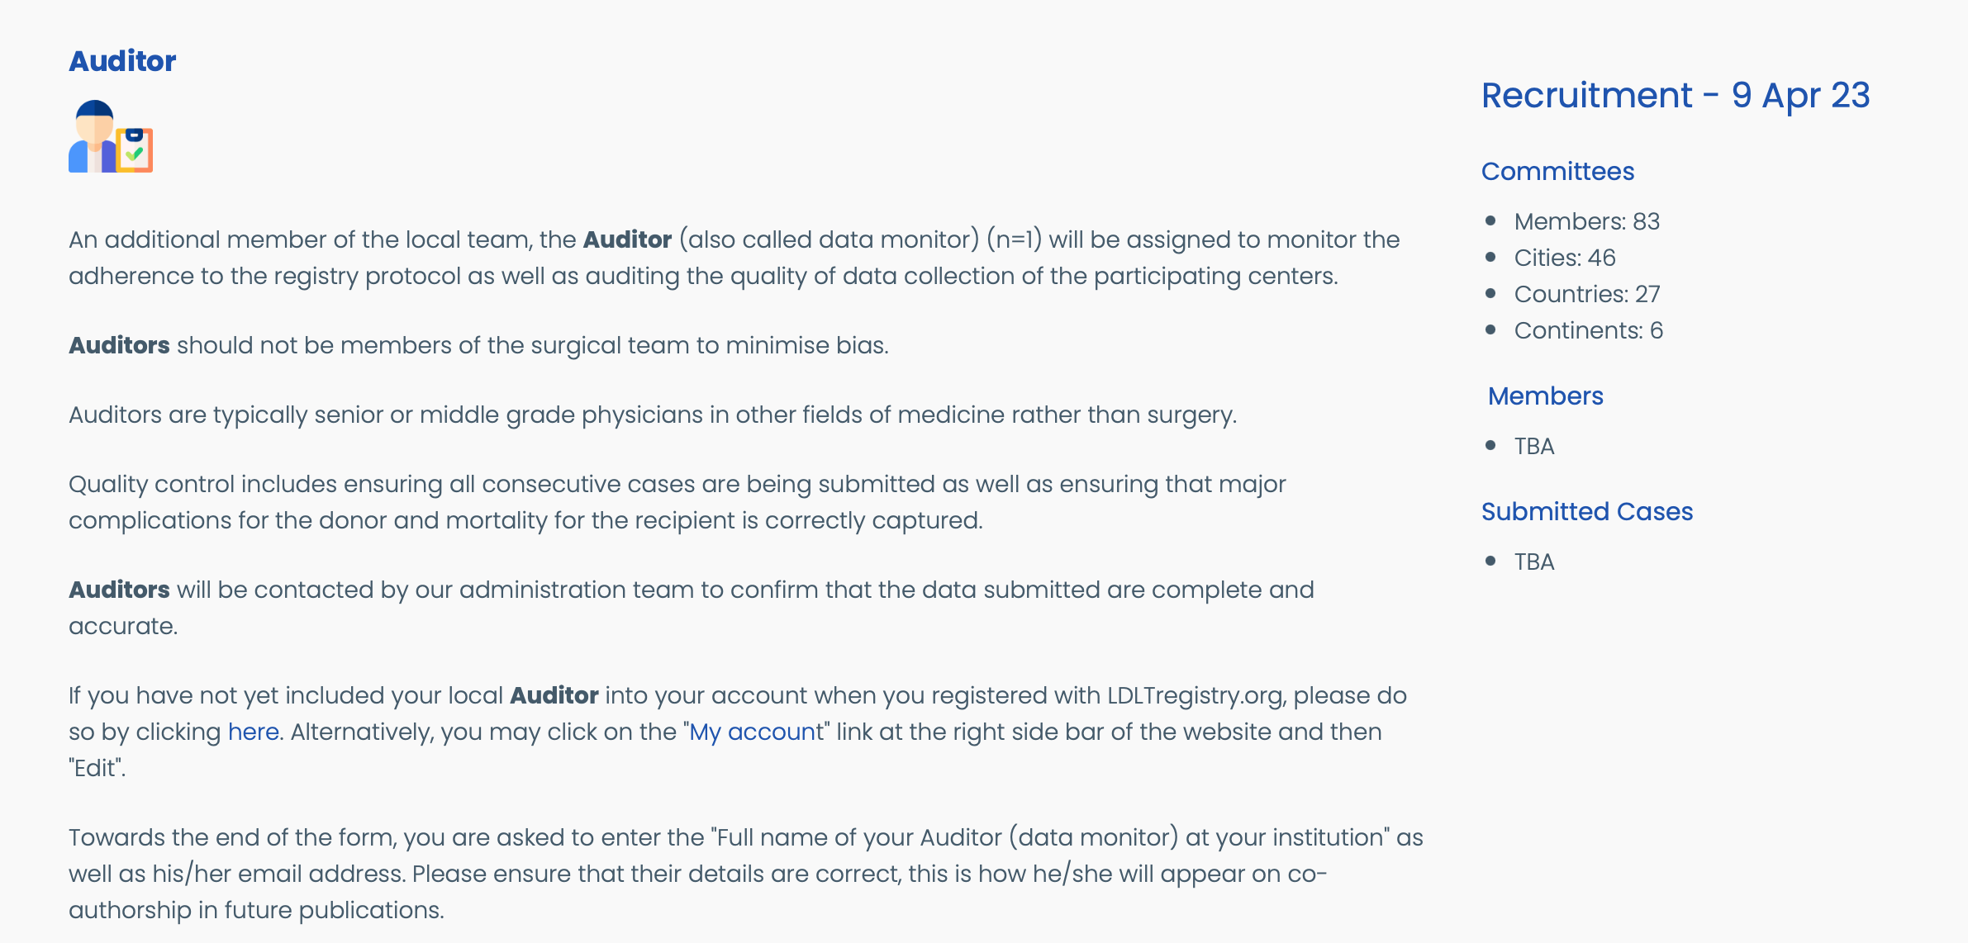
Local team
Auditors, also known as data monitors, will be assigned to monitor the adherence to the registry protocol as well as auditing the quality of data collection of the participating centers.
Auditors should not be members of the surgical team to minimize bias.
Please read the following page for more information: https://ldltregistry.org/formation_local_team
ILDLT | LDLTregistry.org | ILTS

Slide 14
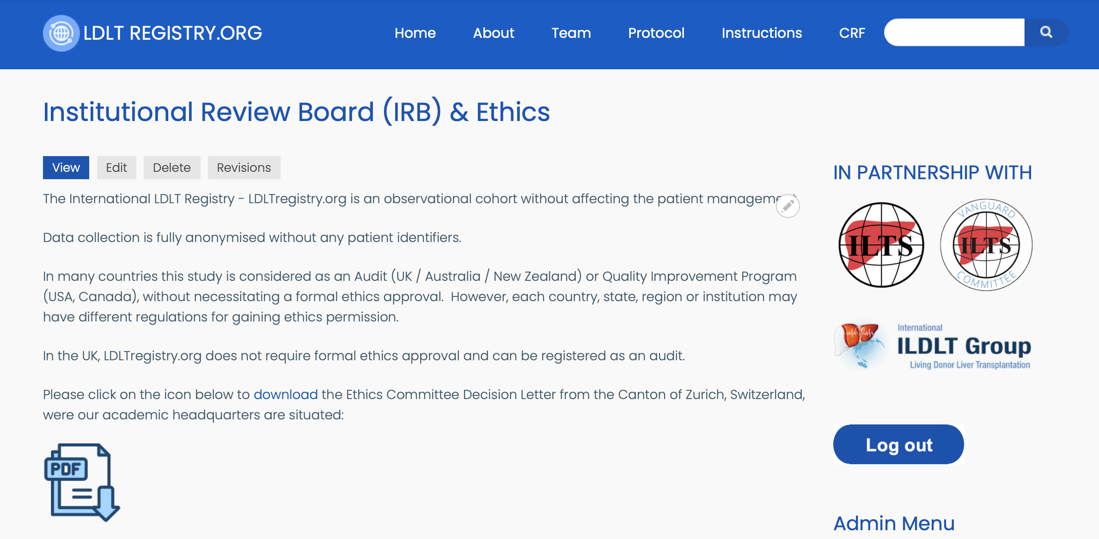
Approval
LDLTregistry.org is an observational cohort without affecting the patient management.
Data collection is fully anonymized without any patient identifiers.
In many countries this registry is considered as an Audit (UK / Australia / New Zealand) or Quality Improvement Program (USA, Canada), without necessitating a formal ethics approval. However, each country, state, region or institution may have different regulations for gaining ethics permission.
ILDLT | LDLTregistry.org | ILTS

Slide 15
Data sharing agreement
Under the ”Instructions” page you will find a lot of useful information, such as the
Data Sharing Agreement template, available for download in Microsoft Office format.
Our Administration team is available to help and support you with preparing your audit / ethics approval documents if required.
ILDLT | LDLTregistry.org | ILTS

Slide 16
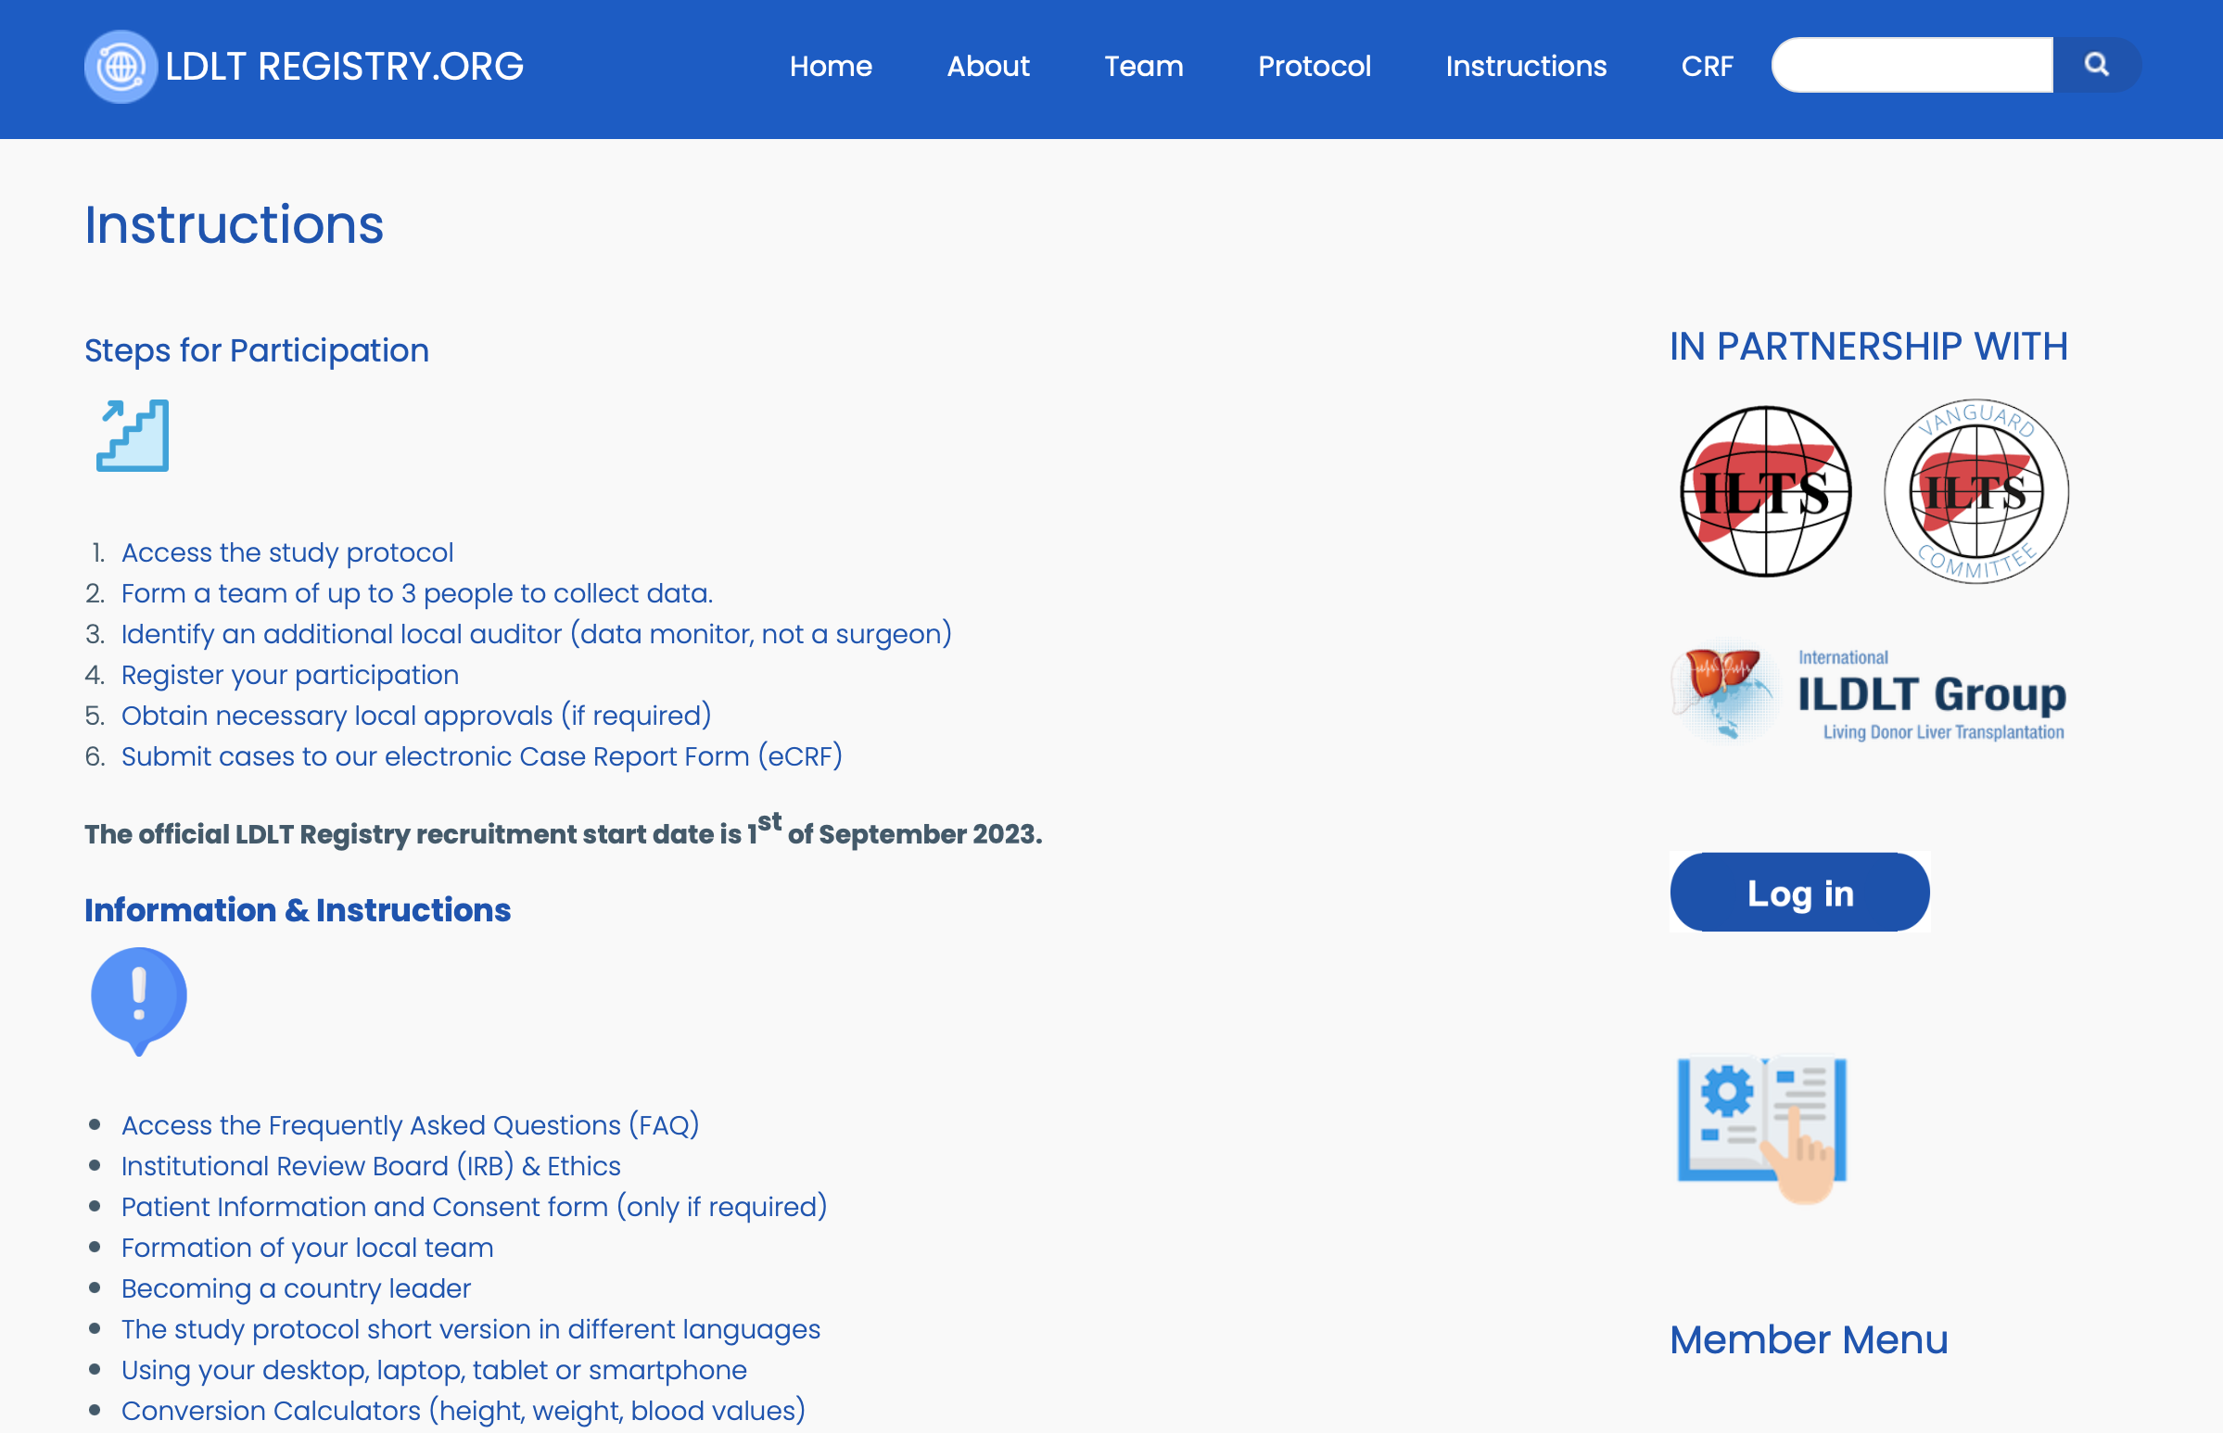
Instructions
The ”Instructions” page is available at the top main menu bar at LDLTregistry.org
ILDLT | LDLTregistry.org | ILTS

Slide 17
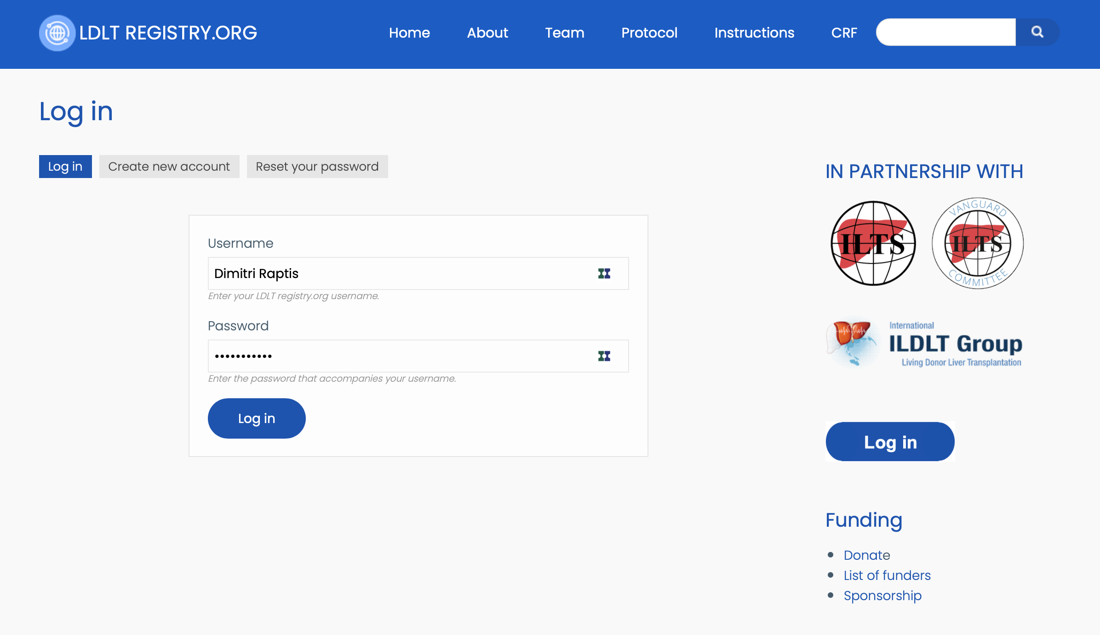
Login
After having your account activated by our admin committee and you have successfully set your
password, you will be able to login to your account by clicking on the ”Log in” button available
at the right sidebar of the platform.
ILDLT | LDLTregistry.org | ILTS

Slide 18
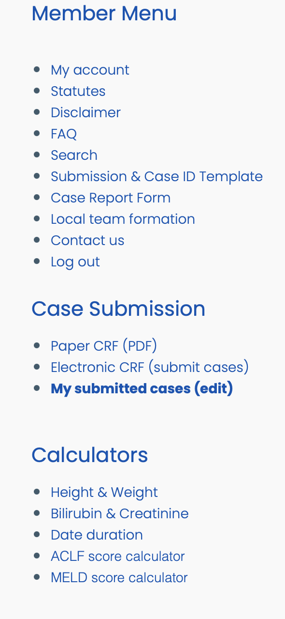
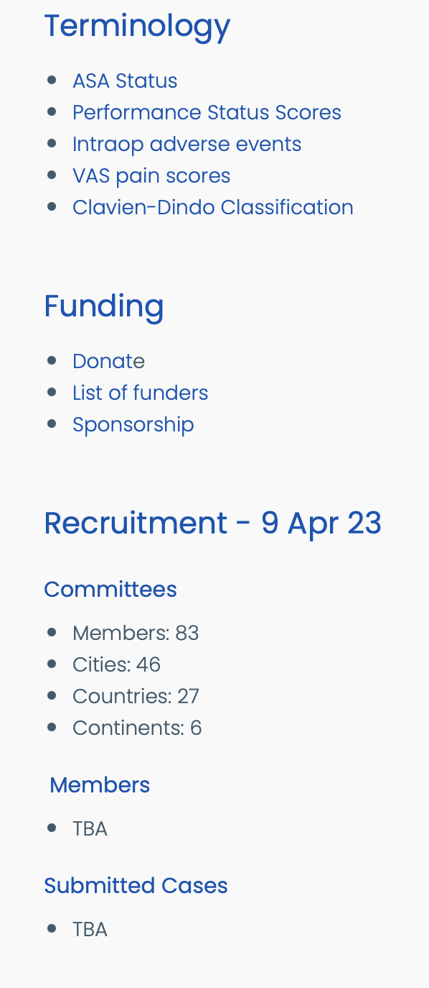
Login
Apart from being able to access the eCRF, additional functions and links will appear at the right sidebar of the platform.
There are shortcut links to the eCRF, your submitted cases for editing, calculators, and information about the terminology used at the CRF.
ILDLT | LDLTregistry.org | ILTS

Slide 19
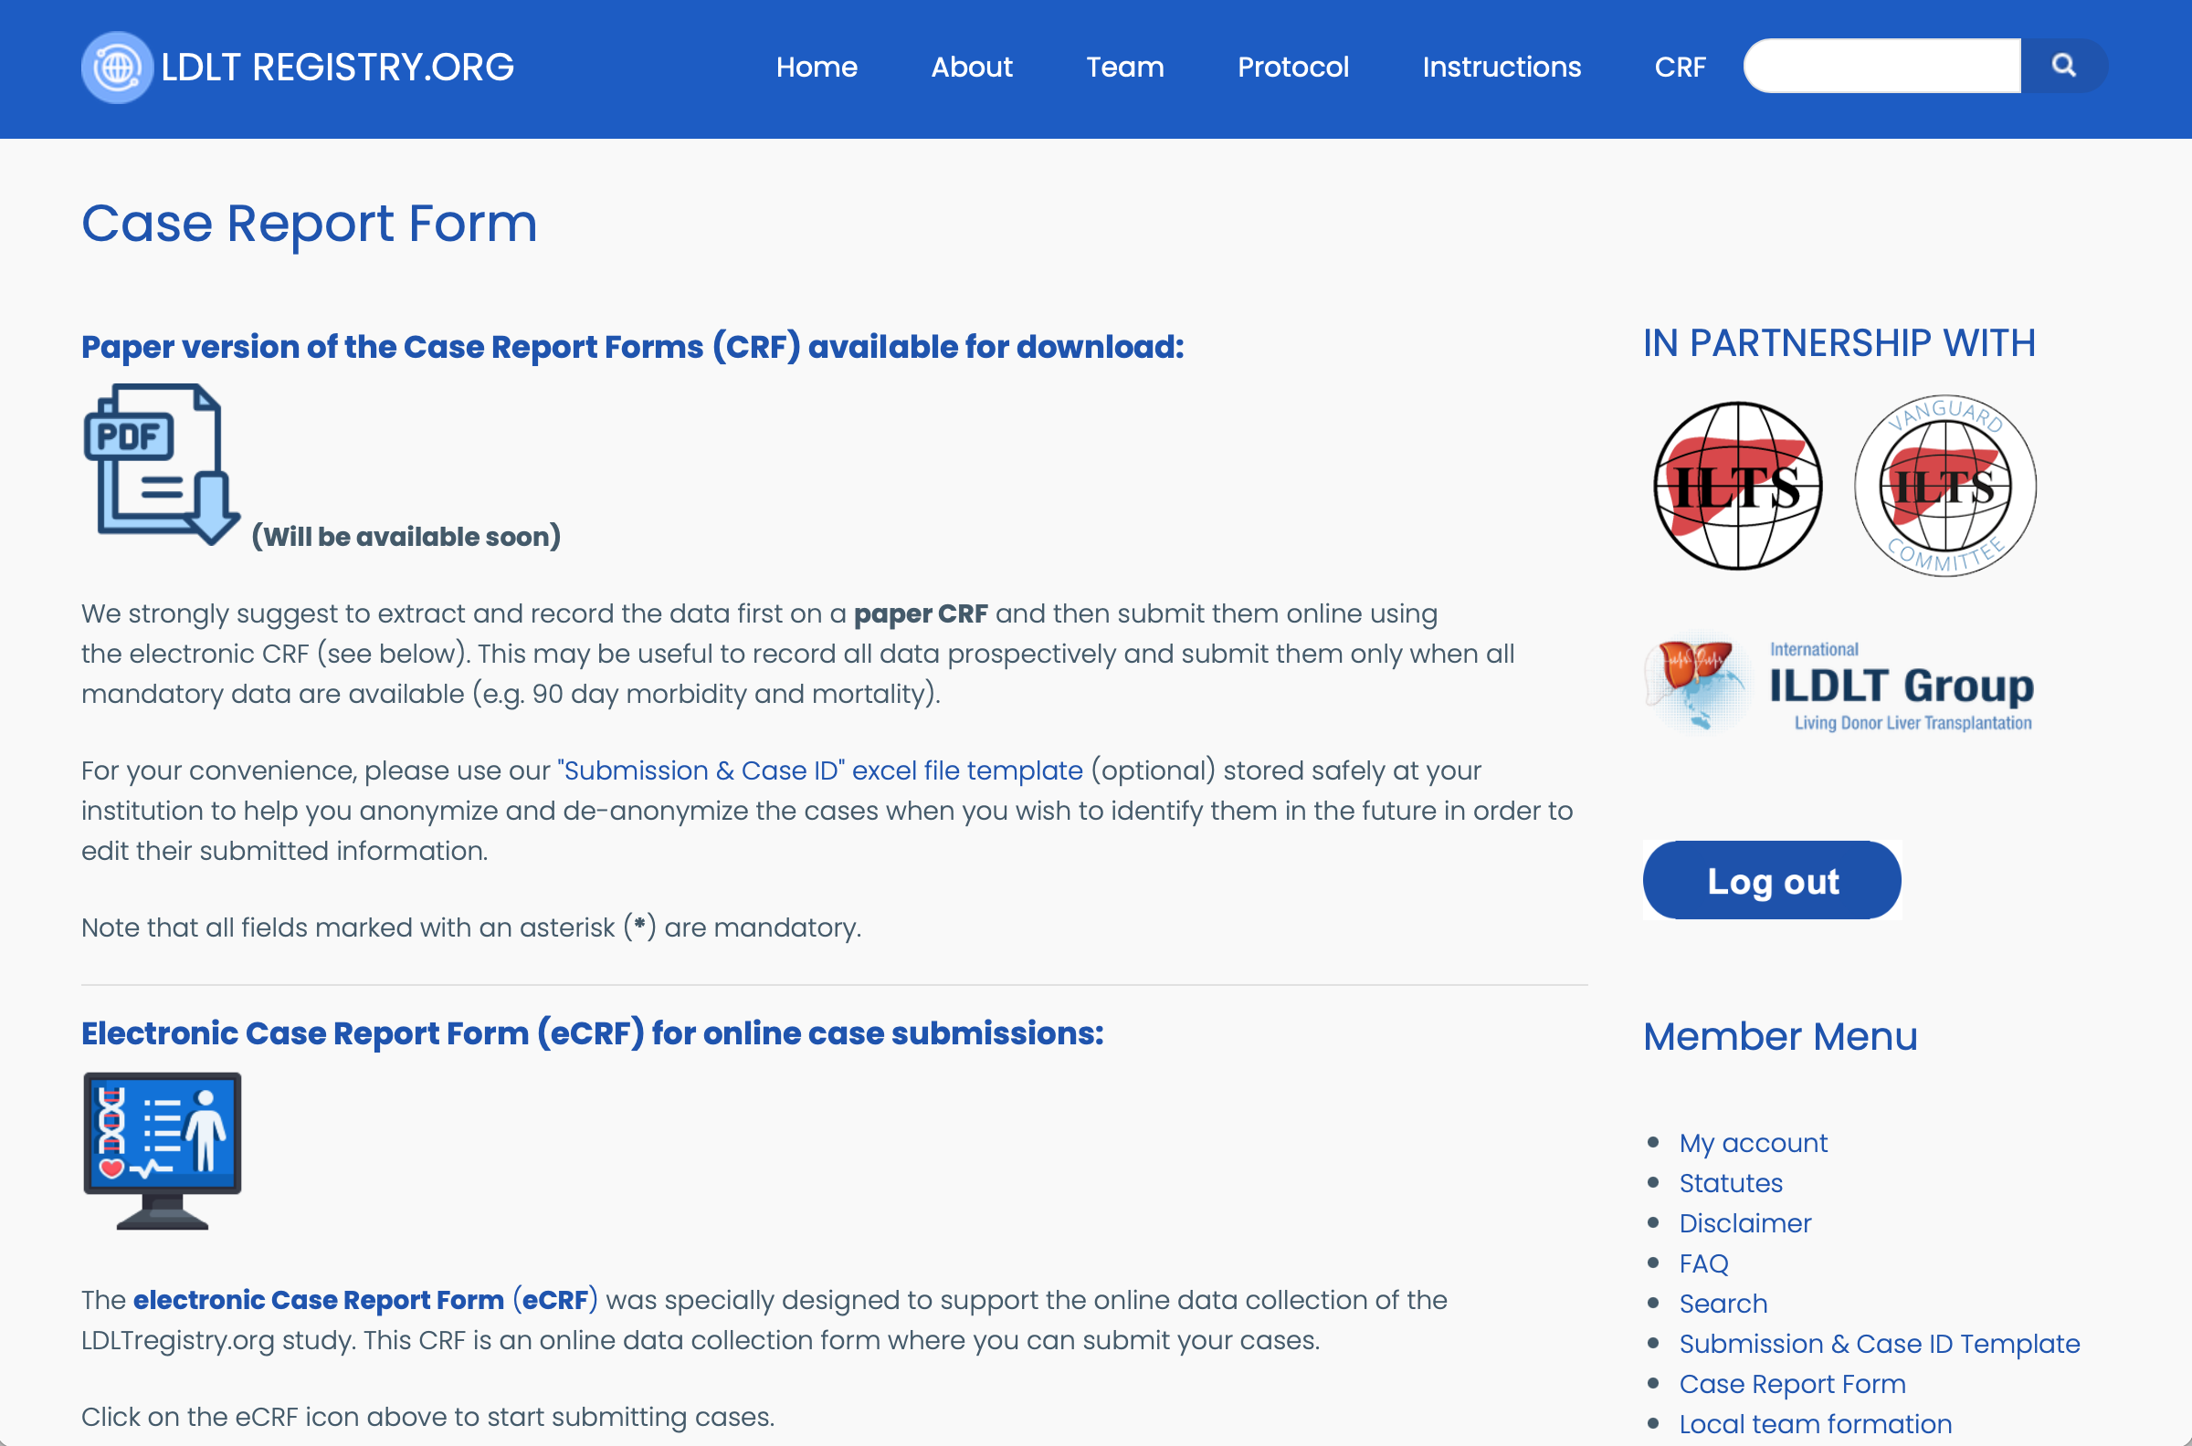
Electronic Case Report Form
The Case Report Form (CRF) / Data Submission Form will be available soon in PDF for download.
The electronic Case Report Form / Data Submission Form is open, cases submitted from 1 Sep 2023 onwards will be included in the registry.
ILDLT | LDLTregistry.org | ILTS

Slide 20
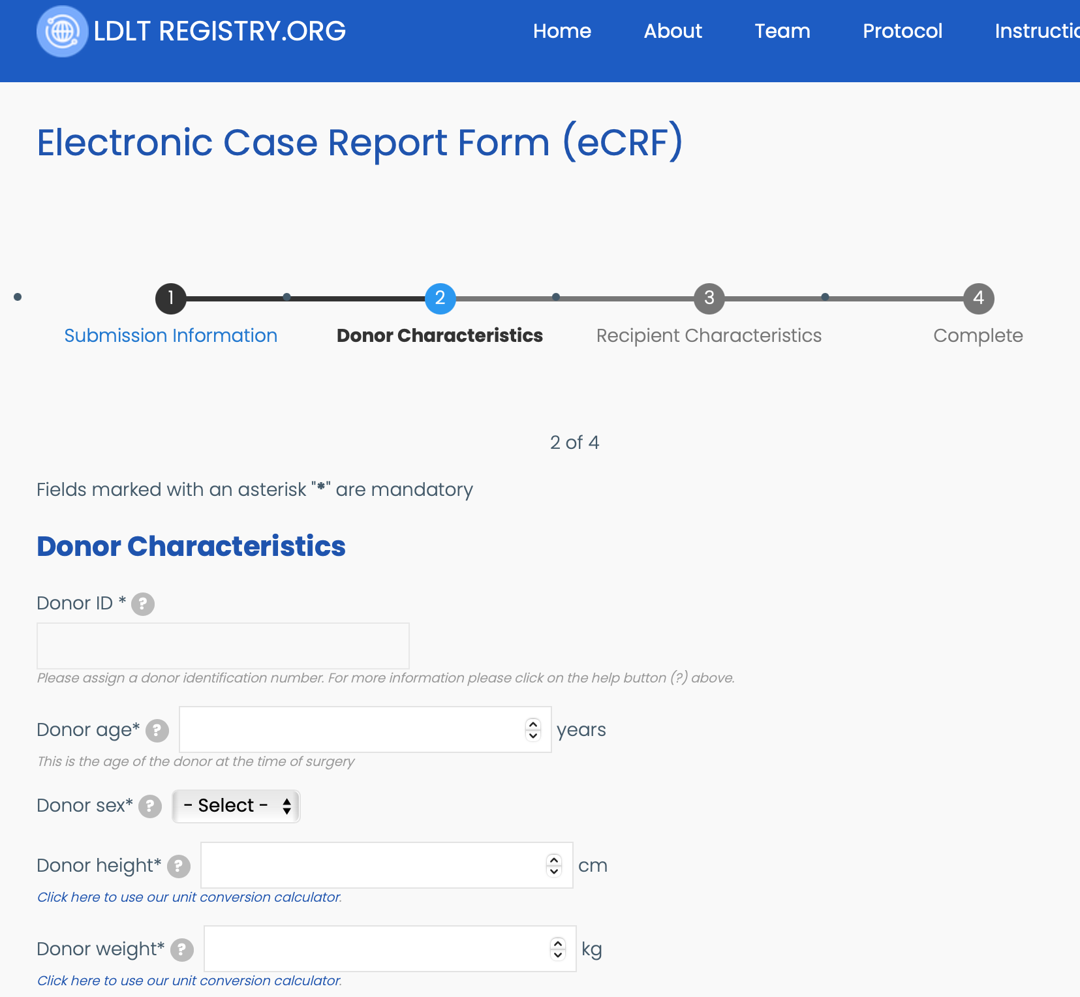
Electronic Case Report Form
Donor
Preop characteristics
Workup data (medical / surgical)
Anesthesia characteristics
Operation characteristics
Postoperative outcomes 90d | 12m
Recipient
Preop characteristics
Operation characteristics
Postoperative outcomes 90d | 12m
The parameters above will be captured for each donor as well as recipient.
First you are required to complete the donor information and then the recipient information before you submit the joined case submission.
You may submit incomplete cases, but you will need to edit them in the future to ensure no missing data. Mandatory parameters are labelled with an ”*”.
ILDLT | LDLTregistry.org | ILTS

Slide 21
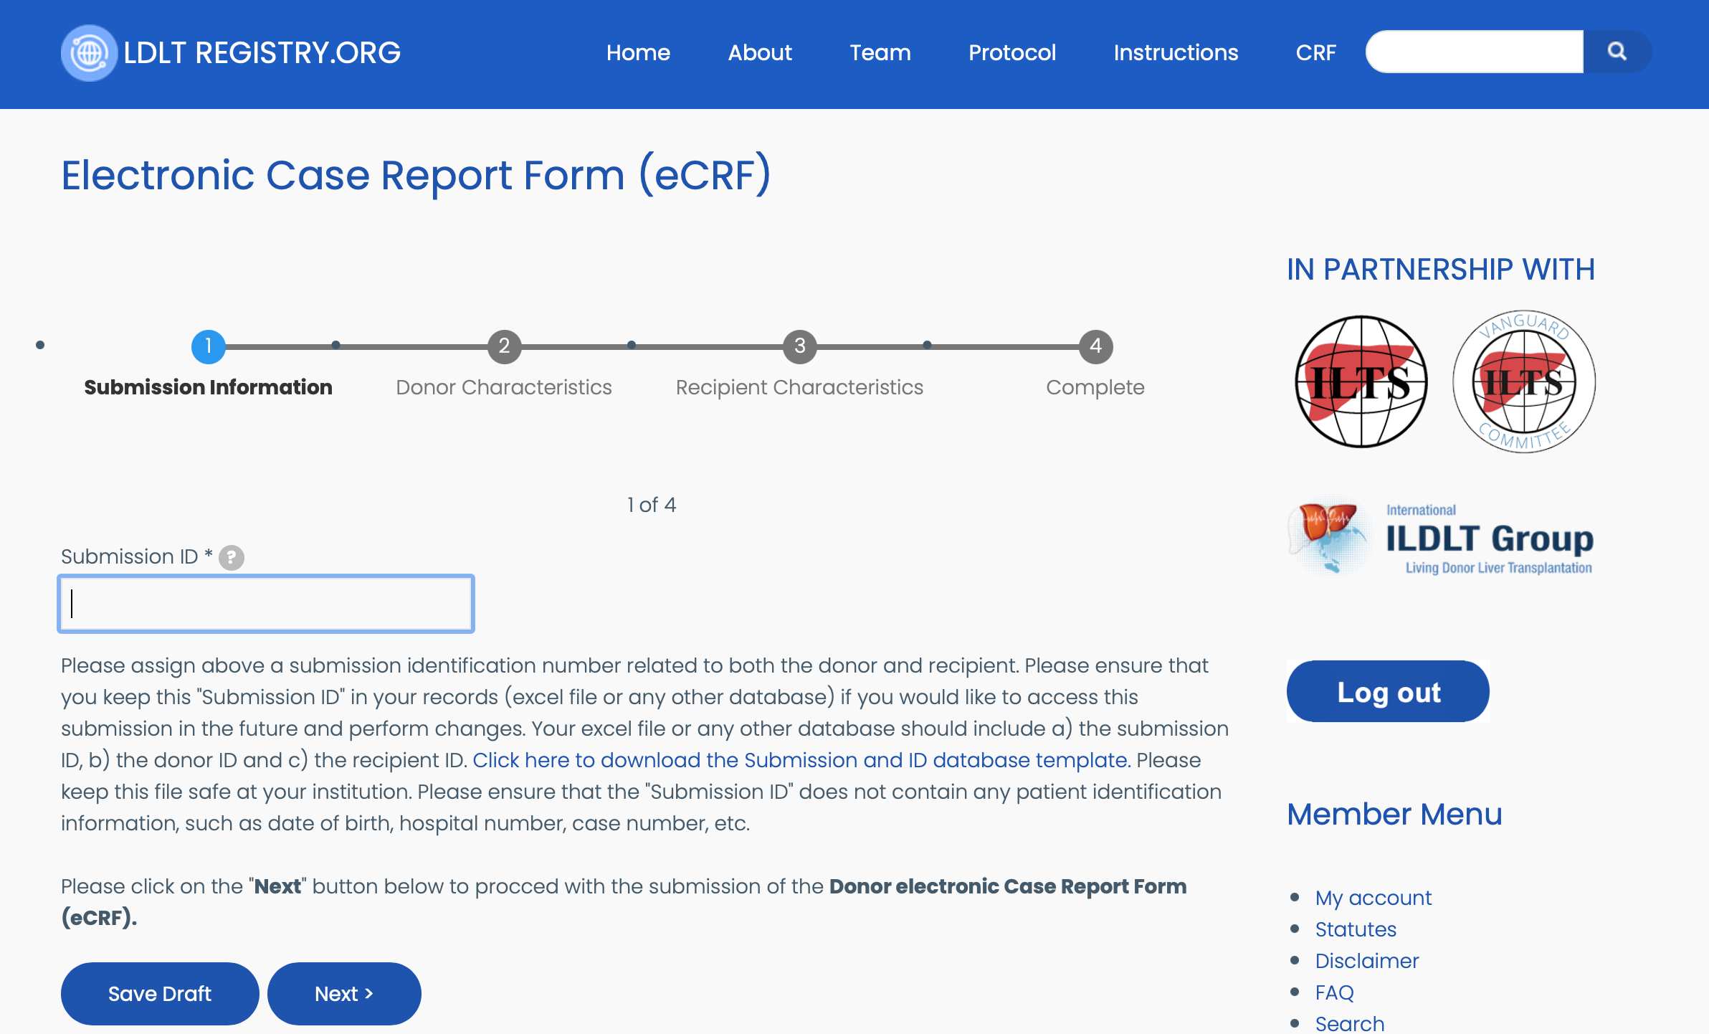
Electronic Case Report Form
The submission ID will link both donor and recipient cases.
ILDLT | LDLTregistry.org | ILTS

Slide 22
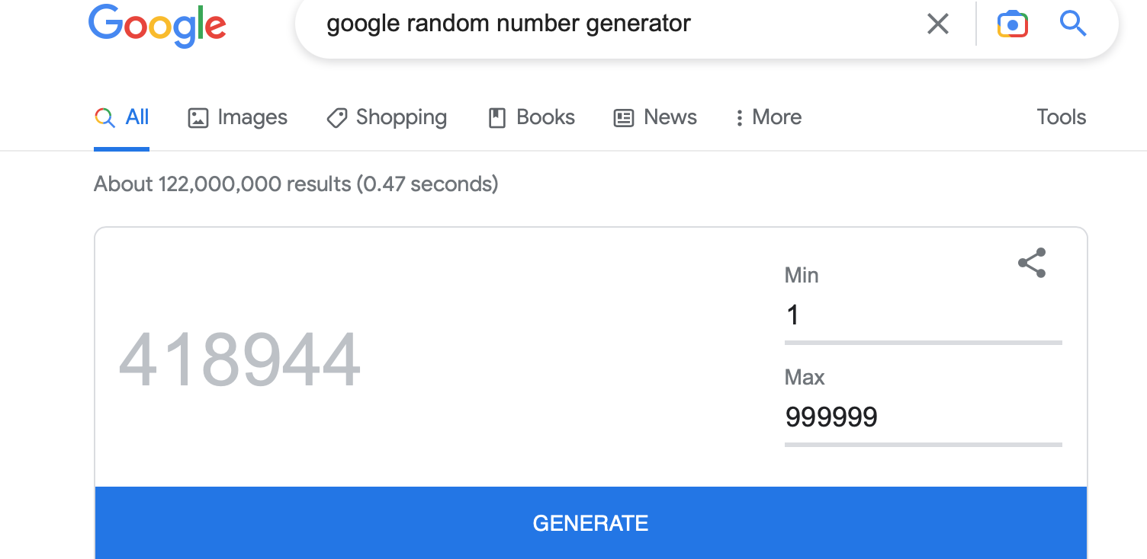
Electronic Case Report Form
We strongly recommend you downloaded and used the excel template that links the Submission ID with the Donor ID and Recipient ID. These IDs should not include any patient identifiers. Please keep this file safe at your institution and link each Donor and Recipient ID to their hospital number. This way you may edit each submission later for completion of data.
Google has a random number generator; you may use this one to create Submission, Donor and Recipient IDs.
These files are available for download at the Instructions page.
ILDLT | LDLTregistry.org | ILTS

Slide 23
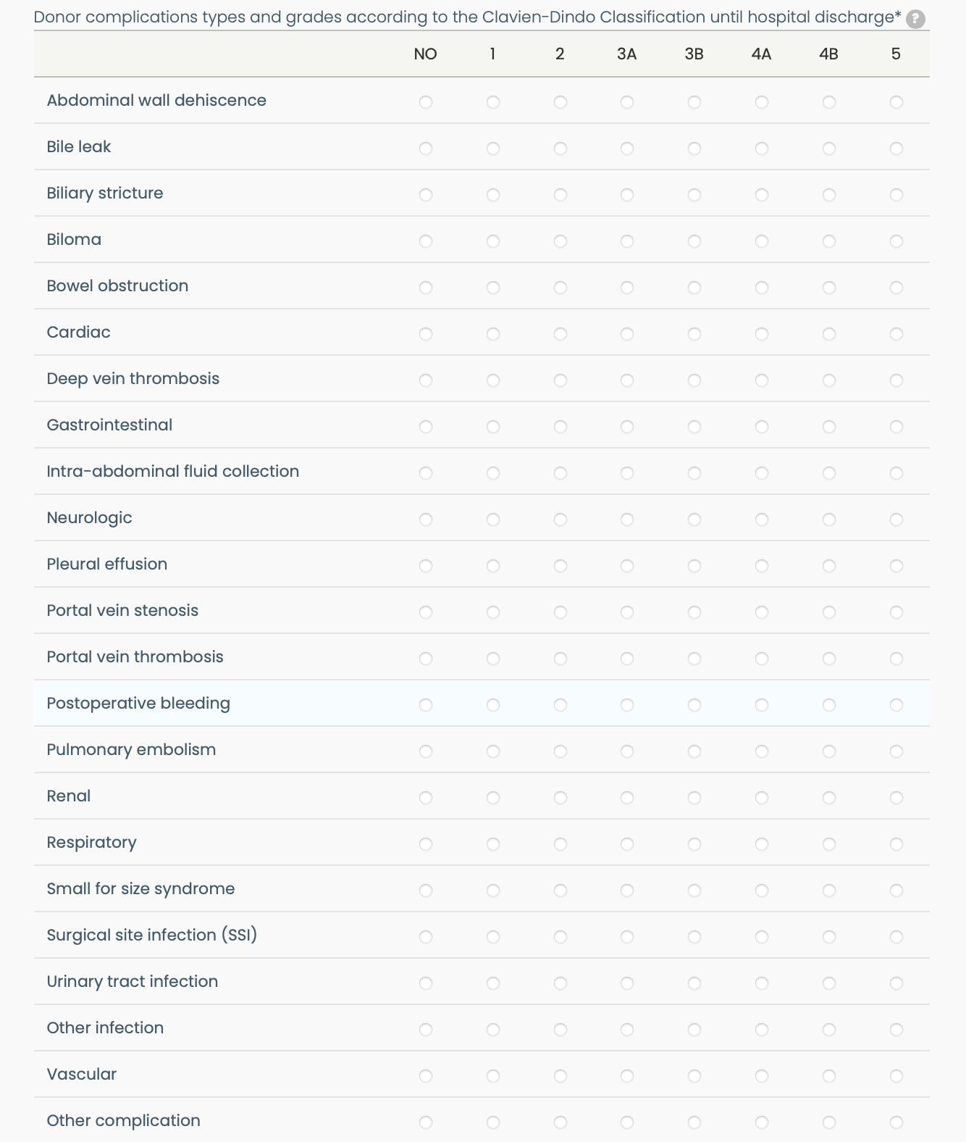
Electronic Case Report Form
The Donor CRF captures morbidity until hospital discharge using the Clavien-Dindo Classification of postoperative complications.
This table will capture both the type and the grade of complications. The first column represents the type of complication, the remaining columns indicate the grade of the complication severity. By clicking on 3b under Abdominal wall dehiscence for example, this indicates a reoperation to manage this complication.
Please ensure you are familiar with the Clavien-Dindo Classification of postoperative complications before you submit any cases.
This classification, among others, is available under the “Terminology” right sidebar menu of our platform.
ILDLT | LDLTregistry.org | ILTS

Slide 24
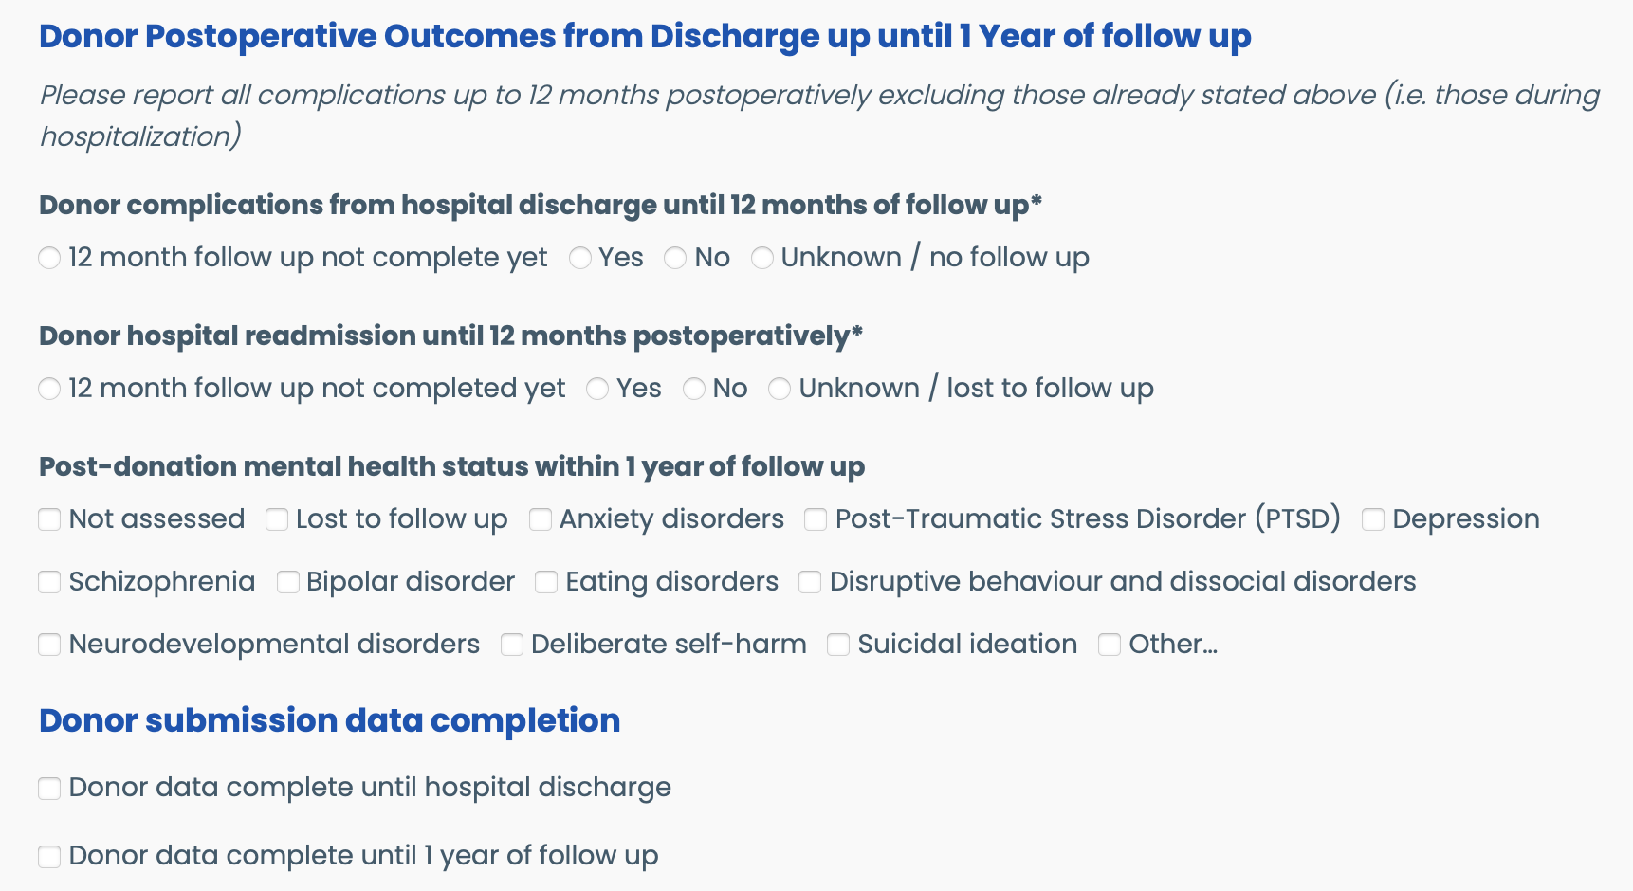
Electronic Case Report Form
Additional morbidity is captured in retrospect from hospital discharge until 1 year of follow up.
Only cases with complete data until hospital discharge will be included in the registry analysis.
ILDLT | LDLTregistry.org | ILTS

Slide 25
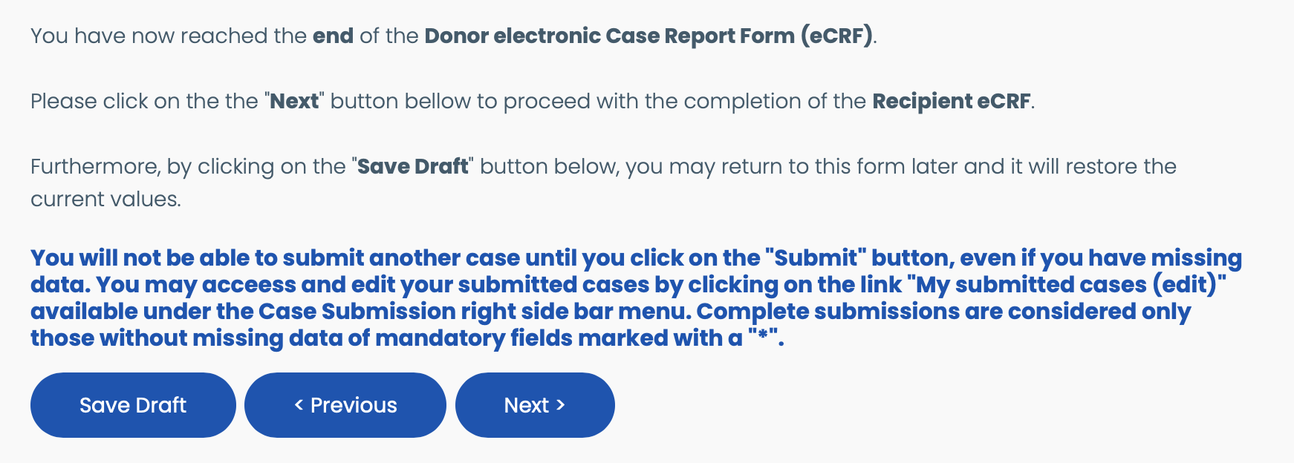
Electronic Case Report Form
You may start completing a case at the eCRF and if you get interrupted or provided all available data, you will be able to save a draft of your submission by clicking on the “Save Draft” button.
When you return, the data will be available for completion. However, you will not be able to create a new case submission until you click on the ”Submit’ button available at the end of the eCRF.
If you have missing information (e.g. follow up data, etc.), please submit the case and access the “My submitted cases (edit)” page to view all your submission and choose the one you would like to edit. If anything is not clear, please feel free to contact us at any time.
ILDLT | LDLTregistry.org | ILTS

Slide 26
Electronic Case Report Form
The case is submitted by clicking on the “Submit” button in order to be able to submit another case in the future.
ILDLT | LDLTregistry.org | ILTS

Slide 27
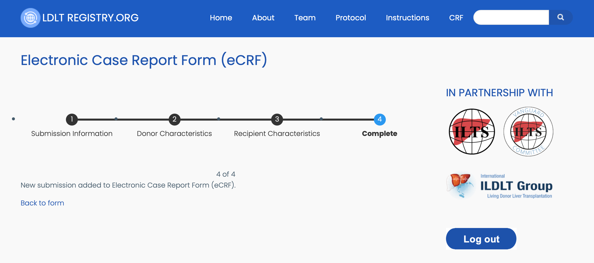
Electronic Case Report Form
As soon as you submit a case, you will be prompted to this confirmation page.
ILDLT | LDLTregistry.org | ILTS

Slide 28
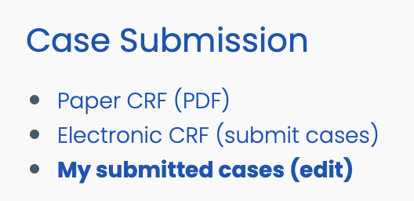
Access submitted cases
The Case Submission Menu Bar is available on the right side of the platform.
ILDLT | LDLTregistry.org | ILTS

Slide 29
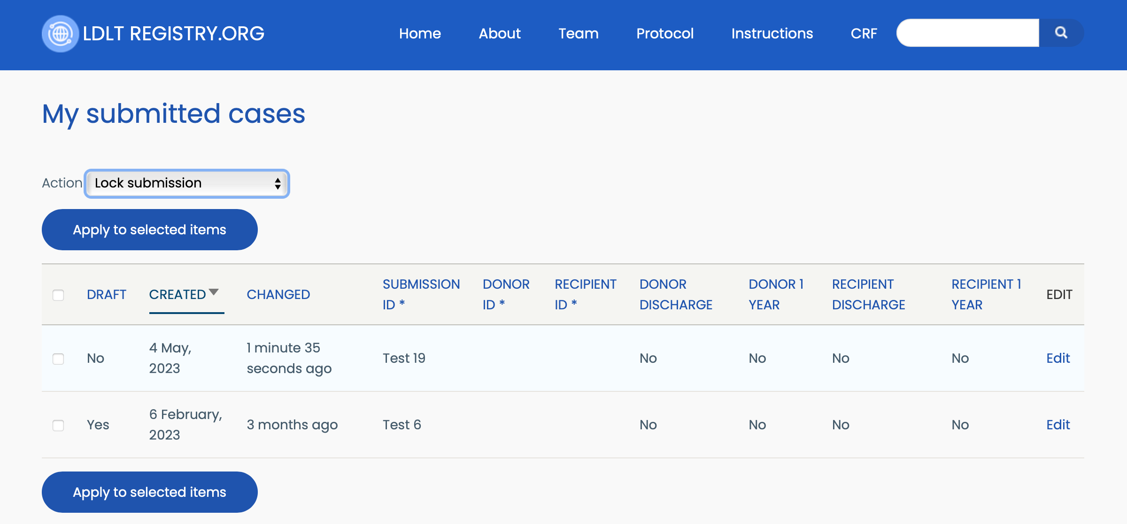
Access submitted cases
This is an example of two previously submitted cases. By clicking on the ”Edit” link on the right, you will be able to make changes to your submission. By clicking on each parameter title, you will be able to sort your submissions accordingly for your convenience, e.g. when looking at those cases with incomplete data submission until hospital discharge.
ILDLT | LDLTregistry.org | ILTS

Slide 30
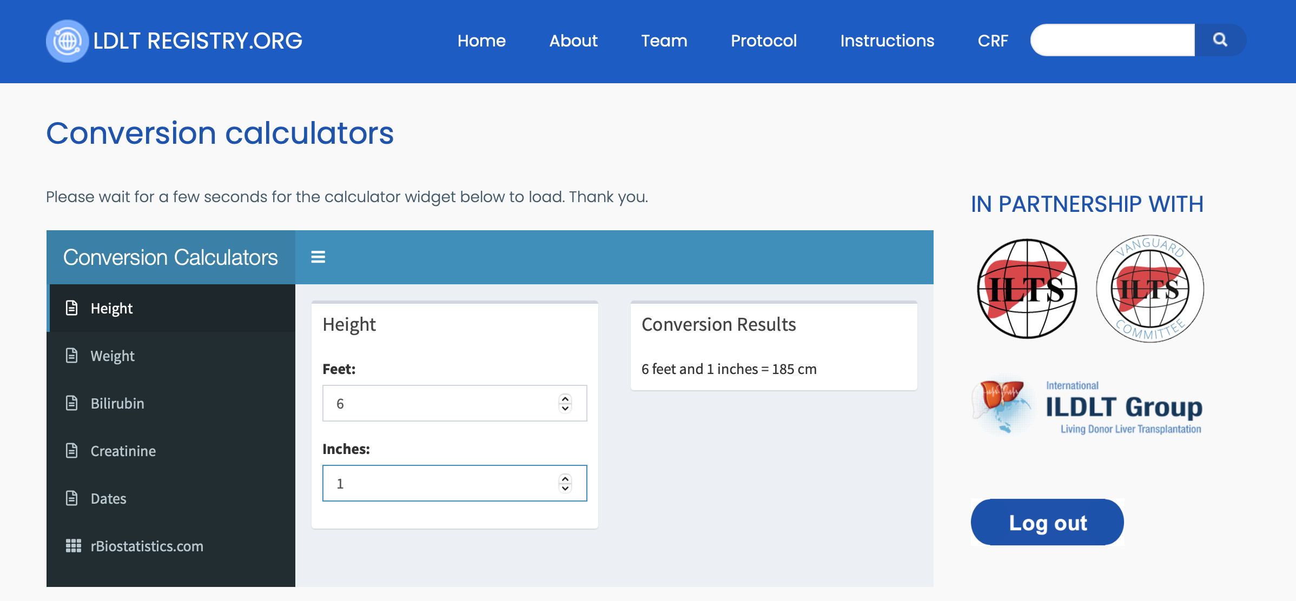
Conversion calculators
We have developed conversion calculators to ensure uniform data collection. Please use them when converting height, weight or laboratory units.
The ”Dates” link on the left will provide you with the number of days between two dates for your convenience.
ILDLT | LDLTregistry.org | ILTS

Slide 31
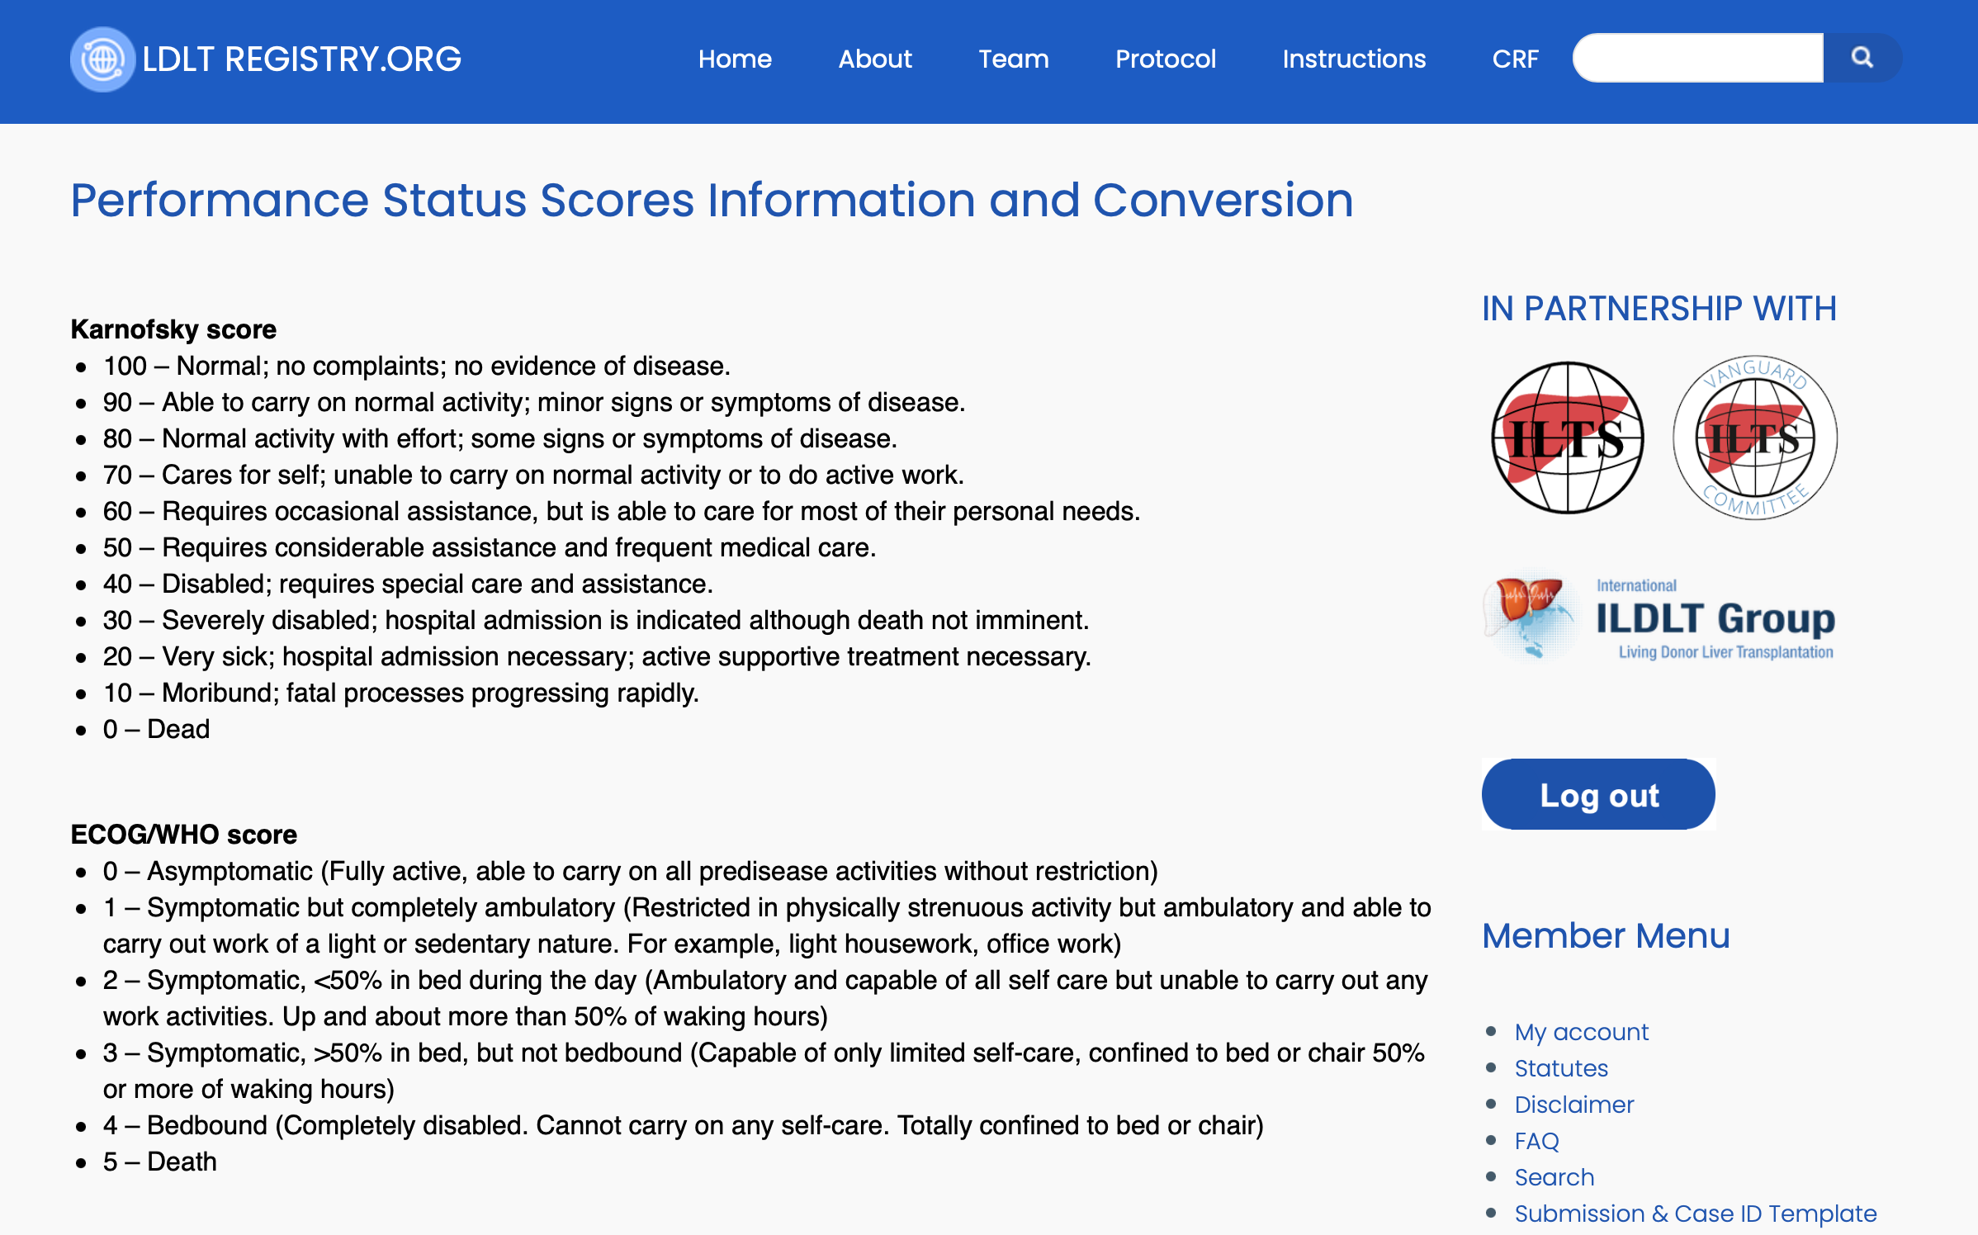
Terminology
The “Terminology” menu at the right sidebar will provide you with information regarding the different scores and classifications used in the eCRF. This is an example of the performance status.
ILDLT | LDLTregistry.org | ILTS

Slide 32
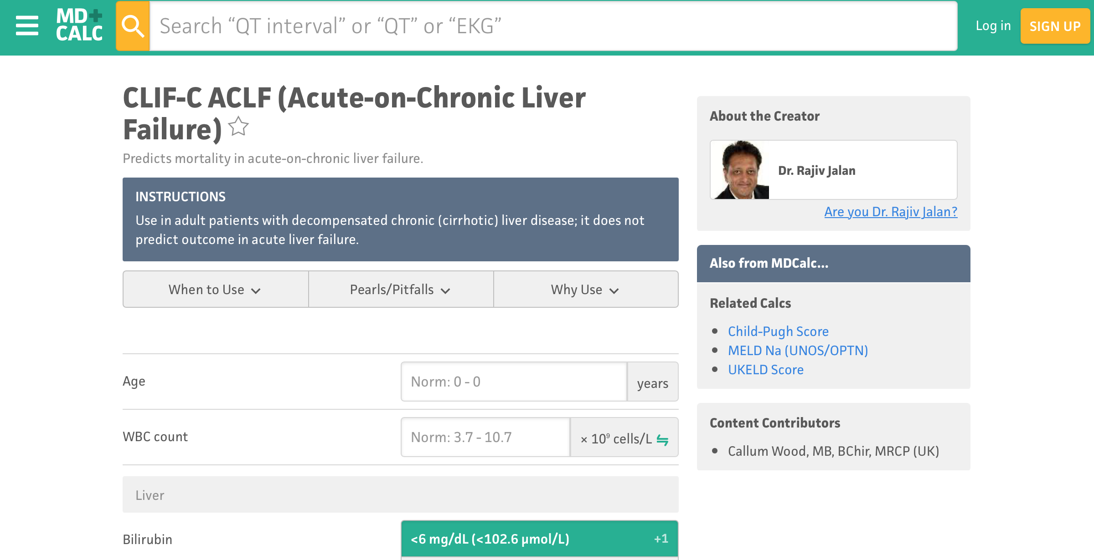
Terminology
This is an example on the Acute-on-Chronic Liver Failure score used in our CRF.
ILDLT | LDLTregistry.org | ILTS

Slide 33
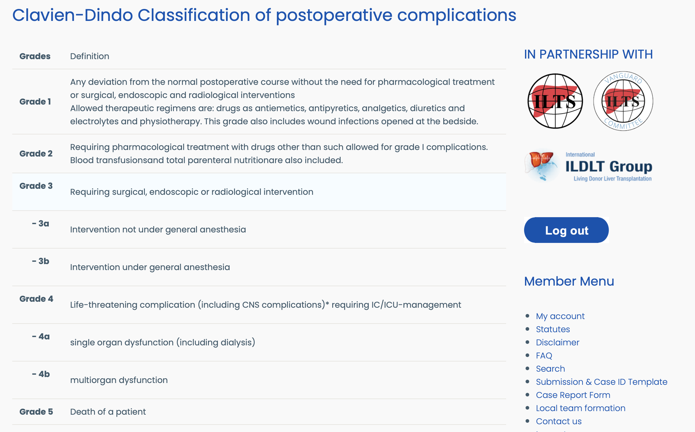
Terminology
Here is the Clavien-Dindo Classification of postoperative surgical complications
ILDLT | LDLTregistry.org | ILTS

Slide 34
Terminology
Since there are many Visual Analogue Scales, here is a universal conversion (0-10) for data uniformity purposes. This is also available under the “Terminology” right sidebar menu.
ILDLT | LDLTregistry.org | ILTS

Slide 35
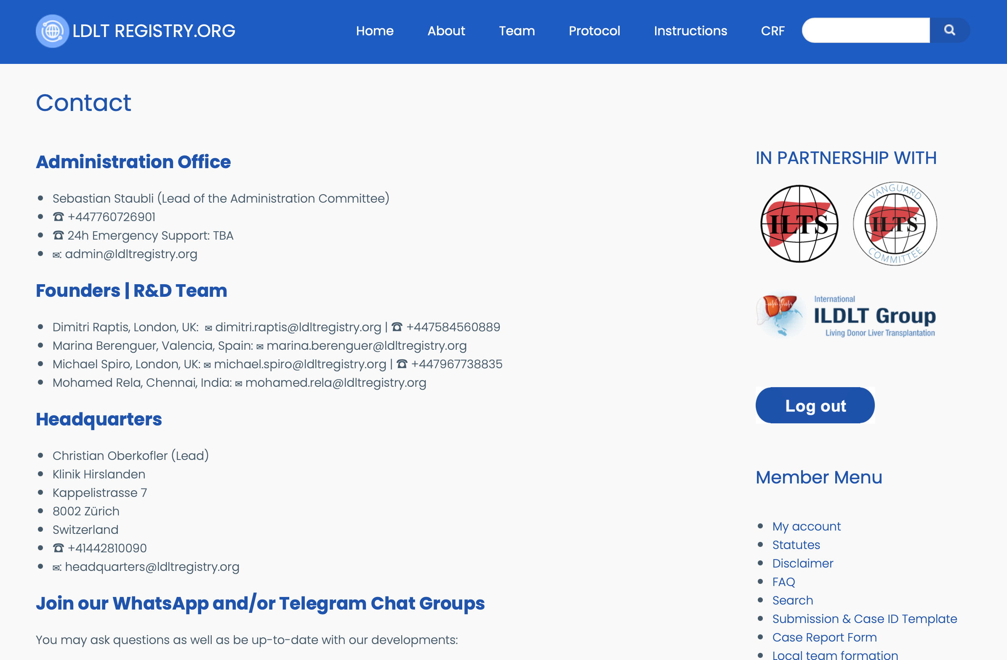
Contact us
Please feel free to contact us at any time. There will be soon a 24/7 support line for urgent questions and trouble shooting.
ILDLT | LDLTregistry.org | ILTS

Slide 36
Thank you!
International Living Donor Liver Transplant Registry
LDLTregistry.org
LDLT

